Slide 1
Synchronisation Challenges in Next Generation RRUs
Advanced Timing for
High Speed Connectivity
©2018 Rakon Limited

Slide 2

Contents
Traditional Base Station Sync
Evolution of 5G and Front-Haul technologies
Sync Architectures for next generation RRUs
Air Interface clocking for 5G RRUs

Slide 3
4G Base Station Clocking functions
T-GM - Telecom Grand Master,
BBU – Base Station Unit,
RRU – Remote Radio Unit
Backhaul
Front-haul
RRU
T-GM
BBU
CPRI
RRU
T-GM
RRU
Base Station Clock Supports
Clock recovery
  GNSS
  Physical Layer
  Packet Layer
Holdover
Radio Clock Supports
Clock recovery
  CPRI layer
Air Interface requirements

Slide 4
Traditional Clocking Implementations
BBU
Network Interface Processing
Processor Subsystem
Base Band
RRU
DAC & PA
GNSS
CPRI
RF PLL
Filters
Timing & Sync
CPRI
SyncE
VCXO
Packet I/O
ADC & LNA
1PPS
External Clocks
OCXO

Slide 5
Next Generation - Physically disconnected RRUs
eCPRI supports Ethernet-switched IP-routed front-haul networks, or similar types of transport networks
T-GM
CU
GNSS
RRU
T-GM
Ethernet
DU
eCPRI
CU
CU
AU
DU
RRU
T-GM - Telecom Grand Master,
CU – (Centralized) Cloud Unit,
DU – Distribution Unit,
AU – Access Unit
CU
Backhaul
Fronthaul I
Fronthaul II

Slide 6
5G Cellular Synchronisation requirements
3GPP requirements
  Air Interface
  Network Interface
    16ppb
Holdover
  Hold previously known
  For x hours/days
Advanced features
  COMP, ICIC
LTE (FDD and TDD) | Wide Area | 50ppb |  | 3GPP TS 36.104 [7] Clause 6.5.1 | Frequency accuracy at the air interface, over one sub-frame period (1ms)
 | Med. Range | 100ppb
 | Local Area | 100ppb
 | Home | 250ppb
LTE-TDD | Wide area, >3km radius |  | 10µs | 3GPP TS 36.133 [8] Clause 7.4.2 | Maximum deviation in frame start times at the air interface (for cells on the same frequency with overlapping coverage areas)
 | Wide area, ≤3km radius |  | 3µs
 | Home BS, >500m rad. |  | 1.33 + T_{prop} µs
 | Home BS, ≤500m rad. |  | 3µs
^{[1]} T_{prop} is the propagation delay between the Home BS and the cell selected
as the network listening synchronisation source
5G will use the 4G synchronisation requirements for now

Slide 7
Transport Network requirements - Sync
Transport Network Synchronisation
  Packet Sync Mechanisms such as IEEE1588
  With or without SyncE
2 Cases for Deployment Scenarios
  Case 1 : Packet clock integrated into eRE
  Case 2 : Packet clock at the network edge
    1PPS/ToD to eREs
Category | |TE| for case 1& 2 | Applications Details | TAE proposed by IEEE801.CM |  | TAE (for Application)
 |  |  | Case 1 | Case 2
A+ | TBD | MIMO or TX diversity transmissions, at each carrier frequency | - | 20ns | 65ns
A | TBD | Intra-band contiguous carrier aggregation, with or without MIMO or TX diversity | 60ns | 70ns | 130ns
B | TBD | A & Inter-band carrier aggregation, with or without MIMO or TX diversity | 100ns | 200ns | 260ns
C | 1100ns | 3GPP LTE TDD | 1100ns | 1100ns | 1500ns

Slide 8
Challenges
Packet based timing recovery
Environmental Aspects
  Higher temperatures of operation
  Higher shock and reliability requirements
Higher Air interface spectral frequencies

Slide 9
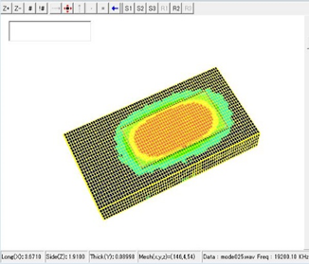
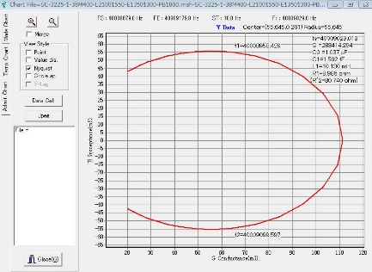
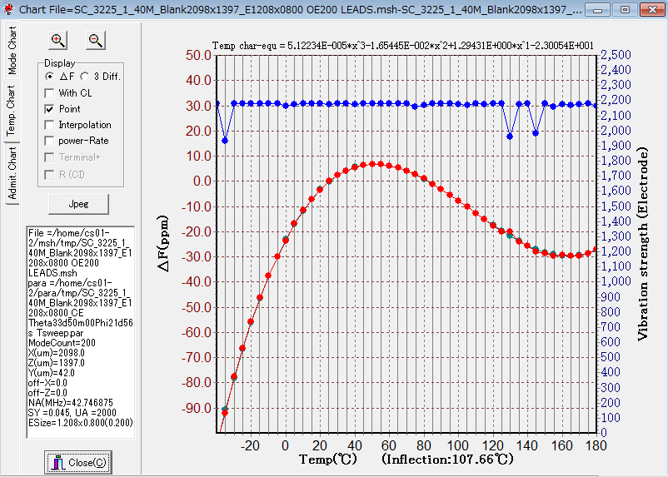
Environmental Effects
Higher Temperatures of operation
  Densification demands modular equipment configurations
Weatherproof outdoor equipment
  Fan-less, sealed enclosures designs
Massive MIMO RRUs
  Higher Power consuming radios
  PCBs getting hotter > 85degC
Outdoor deployments
  Lamp posts & structures
  Requires low shock & vibration
Reference Clocking challenges
  Higher temperature of operations
    All ASICs - special process solutions
    Specific components
Reference Clocking challenges
  Special designs resilient to shock & Vibration
    SC-cut strip crystal with G-sensitivity < 1ppb/G
    Enhanced performance in vibration prone environments

Slide 10
5G RRU timing evolution
Packet interface into RRU necessitates protocol layer timing recovery
Packet timing recovery needs higher stability reference clocks
DAC & PA
DAC & PA
CPRI
RF PLL
Filters
eCPRI/Ethe-rnet
PTP PLL
RF PLL
Filters
VCXO
TCXO
OCXO
VCXO
ADC & LNA
ADC & LNA

Slide 11
Options for Synchronisation
Clocking scenarios
  GNSS based timing
  PTP with SyncE
  PTP with enhanced SyncE
  PTP with no SyncE
Worst Case PDV into the Radio
GNSS based timing
  1PPS synchronisation input
  Rule of thumb
    Loop filter < 1/10 of input clocking
  Typical loop bandwidths ~30mHz

Slide 12
PTP with SyncE or Enhanced SyncE
Network Limit of G.8262/G.8262.1 from G.8261
*G.8262.1 may have a reduced network limit
Requirements

Slide 13
Generalized approach for SyncE / eSyncE
Frequency offset = A * 2 * pi * f_{bw}
To get a 20ppb ffo at the synchronizer output
The filter value needs to be 12mHz

Slide 14
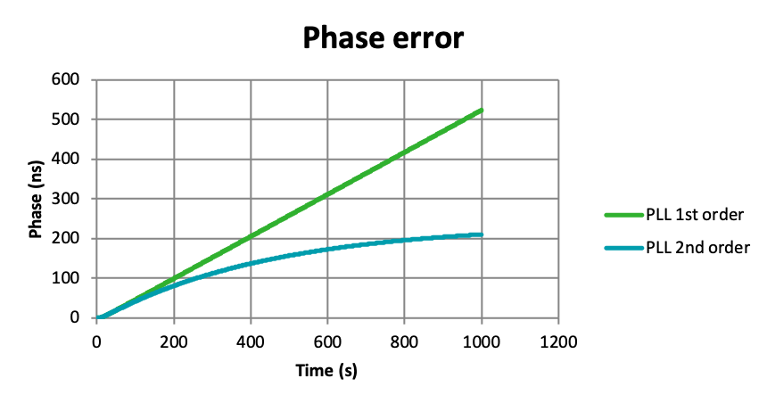
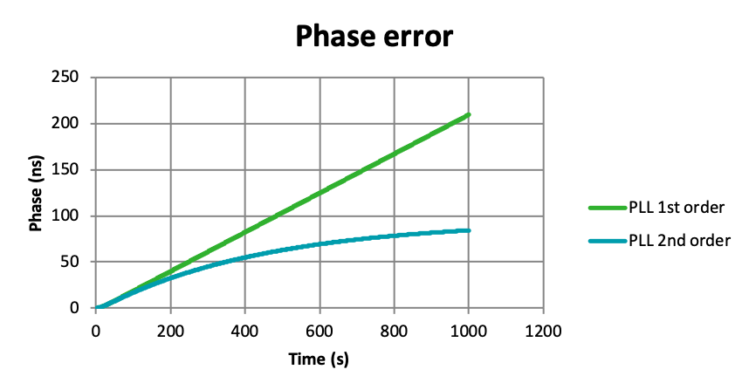
Worst Case Error across temperature
Assumptions :
- Wander generation with ideal input case, filter value 12mHz
- The radio may see a full range of temperature variations – 0.5degC/min
With 0.5ppb/degC
With 0.2ppb/degC
200+ns
80+ns

Slide 15


RRU Synchronisation solutions
 | Frequency (Package size) | Stability (Temperature range) | Slope (ΔF/ΔT) | Aging (10 years) | Phase Noise (Typ. @ 19.2MHz)
TCXO | 10 – 40 MHz (5.0 x 3.2 mm) (7.0 x 5.0 mm) | ±50 ppb (-40 to 85°C) ±100 ppb (-40 to 105°C) | ±20 to ±10 ppb/°C | 3ppm | -123 dBc/Hz @100Hz -155 dBc/Hz @10kHz -156 dBc/Hz @ 100kHz
50ppb TCXO
Key Features:
  Temperature stability : +/-50ppb (-40 to 85C)
  High temperature ranges : -55 to 105°C available
  <5ppb/degC temperature slope
  7mmX5mm
Mini OCXO
 | Frequency (Package size) | Stability (Temperature range) | Slope (ΔF/ΔT) | Aging (10 years) | Phase Noise (Typ. @ 50 MHz)
Mini OCXO | 10 – 50 MHz (9.7 x 7.5 mm) (7.0 x 5.0 mm) | ±10 ppb (-40 to 85°C) ±20 ppb (-40 to 95°C) | ±1 to ±1.5 ppb/°C | 3ppm | -148 dBc/Hz @100Hz -154 dBc/Hz @10kHz -156 dBc/Hz @ 100kHz
Key Features:
  +/-10ppb (-40 to 85C) temperature stability
  9mmx7mm, 7mmx5mm next generation
  <0.5ppb/degC temperature slope
  High temperature ranges : 105°C available
  Fast Start-up times

Slide 16
Radio Clock reference challenges
4G clocks cover up to 2.4GHz frequencies
5G covers high spectral frequencies
  Up to 100GHz
4G / LTE bands

Slide 17
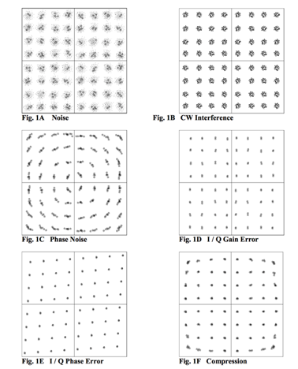
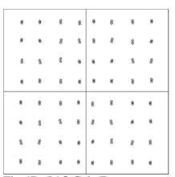
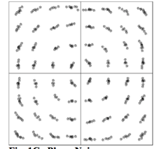
Contribution to EVM - Phase noise
Reference clock phase noise contributes to EVM
  As the modulation level increase (like 256 QAM) the constellations are dense, minimal close-in noise desired
Ideal Constellations
Constellations with high phase noise

Slide 18
RF References for 5G
Higher spectral frequencies need low phase noise reference clocks – GHz VCXOs
DAC & PA
DAC & PA
CPRI
RF PLL
Filters
eCPRI/Ethe-rnet
PTP PLL
RF PLL
RF PLL
Filters
VCXO
TCXO
OCXO
VCXO
GHz VCXO
ADC & LNA
ADC & LNA

Slide 19
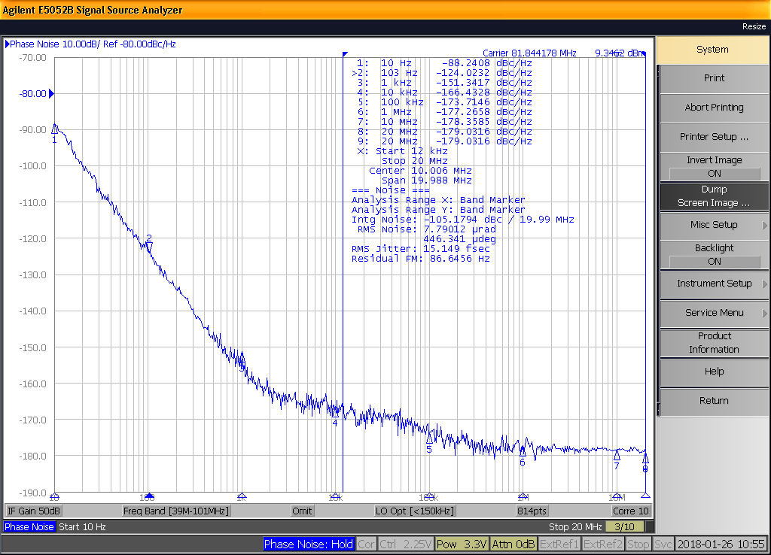
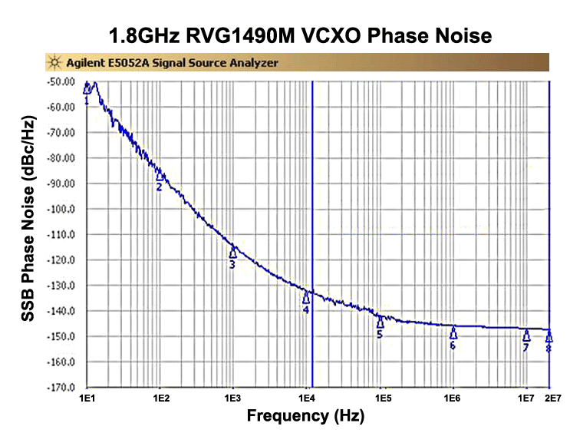
High frequency clock references
Two clocking reference options
  Ultra low phase noise, low frequency
  Low phase noise, GHz frequency
Ultra low phase noise solutions
  122.88M VCXO
GHz frequency solutions
  ~2.5GHz VCXO solutions

Slide 20
Conclusion
Next Generation Base station architectures poses synchronisation challenges for RRU implementations
Network clock recovery will be based on packet clock recovery methods, needs more stable reference clock than current
Environmental effects are critical
Higher spectral frequencies requires very low noise reference clocks for superior performance

Slide 21
Acknowledgements
References
IEEE P802.1CM/D2.2 Draft Standard for Local and metropolitan area networks—Time-Sensitive Networking for Front-haul
eCPRI Interface Specification: eCPRI Specification V1.1 - Common Public Radio Interface
CPRI Interface Specification : CPRI Specification V7.0 Common Public Radio Interface
eCPRI Transport Network D0.1 - Common Public Radio Interface: Requirements for the eCPRI Transport Network
IEEE1914.3/D3.2 : Draft Standard for Radio over Ethernet Encapsulations and Mappings
Dr. Nigel Hardy, Principal Design Engineer, Rakon UK Limited
Cyril Datin, R&D - Product Development Manager, Rakon France SAS
Florentin Margarit; Product R&D Engineering, Rakon UK Limited, New Zealand

Slide 22

Thank you
www.rakon.com

